Slide 1
Introduction
Metadata: The Hidden Layer of the Internet
Student: Andronov Denis Andreevich 241-3210
2026

Slide 2
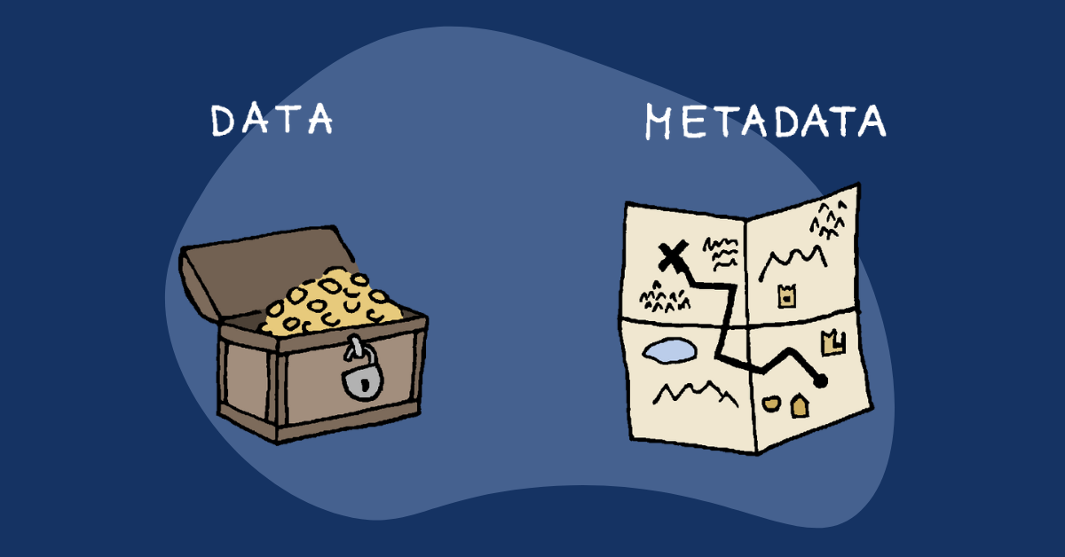
What is metadata?
Metadata is data that describes other data.
In simple terms:
it is “information about information”
Examples:
  file creation date
  document author
  image size
  photo location (GPS)

Slide 3
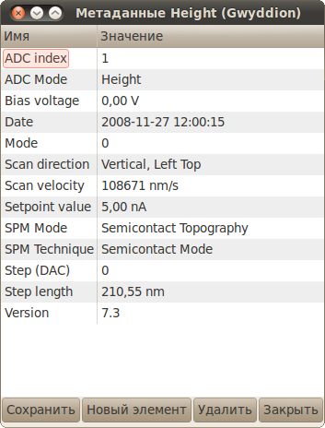
Simple example
A photo on your phone:
the image itself → data
date, location, camera model → metadata
You see the picture, but the system “sees” much more behind it

Slide 4
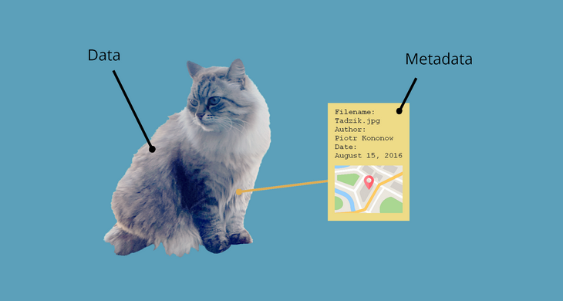
Where is metadata used?
Search engines (Google)
Social media platforms (Instagram, TikTok)
Music services (Spotify)
File systems on computers
Online shopping platforms

Slide 5
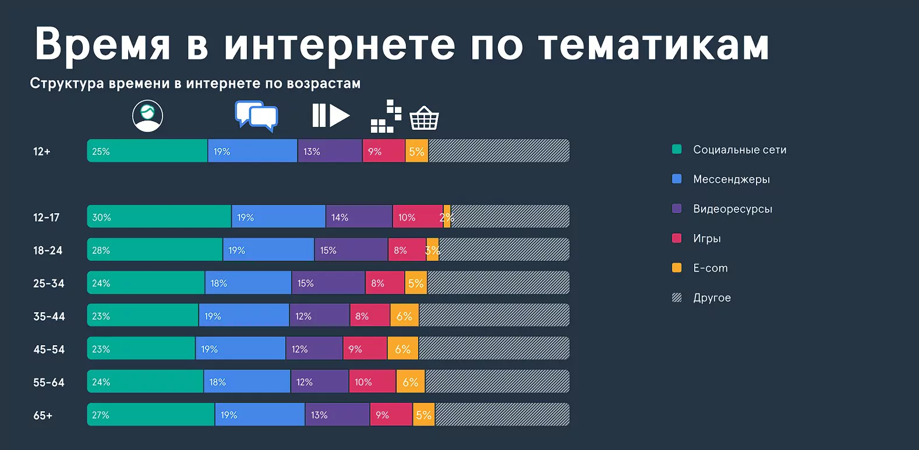
Why is metadata important?
helps find information faster
organizes huge amounts of data
improves recommendation systems
👉 Without metadata, the internet would be chaotic and unstructured

Slide 6
Metadata and privacy
Metadata can reveal:
  your location
  your activity patterns
  the devices you use
⚠️ Even without reading message content, a lot can still be learned about a person

Slide 7
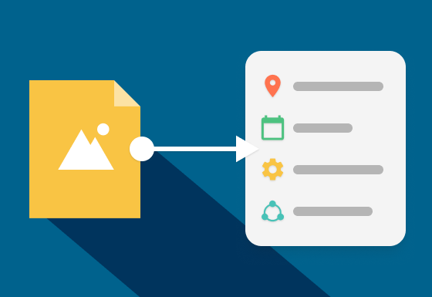
Real-life example
a photo without metadata = just an imagea photo with metadata = a story (where, when, and how it was taken)

Slide 8
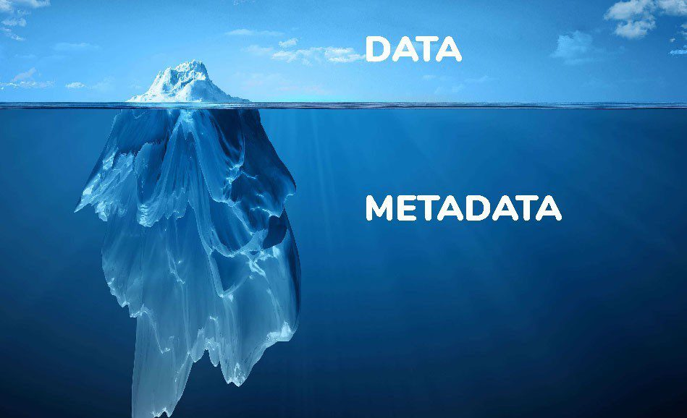
Conclusion
Metadata is an invisible layer of the internet that:
structures data
powers digital services
affects user privacy

Slide 9

Thanks for you attention

